Slide 1
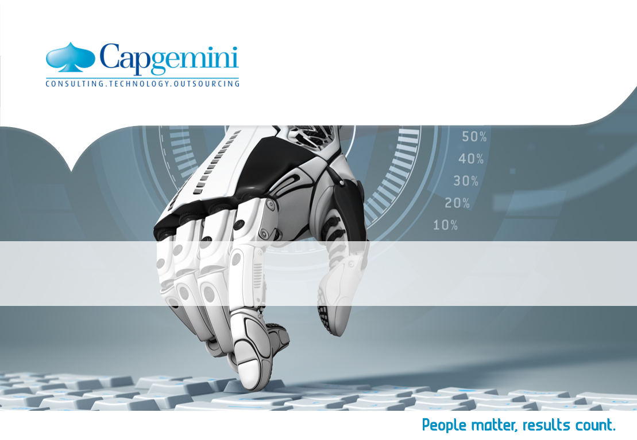
Machine Learning using Python

Slide 2
What is Machine Learning?
Machine learning is a method of data analysis that automates analytical model building.
It uses algorithms.
These algorithms iteratively learn from data.
Machine learning allows computers to find hidden insights without being explicitly programmed where to look.
Instead of extracting data for human comprehension -- as is the case in data mining applications -- machine learning uses that data to detect patterns in data and adjust program actions accordingly
Notes:
Facebook's News Feed uses machine learning to personalize each member's feed. If a member frequently stops scrolling in order to read or "like" a particular friend's posts, the News Feed will start to show more of that friend's activity earlier in the feed. Behind the scenes, the software is simply using statistical analysis and predictive analytics to identify patterns in the user's data and use to patterns to populate the News Feed. Should the member no longer stop to read, like or comment on the friend's posts, that new data will be included in the data set and the News Feed will adjust accordingly.

Slide 3
Types of Machine Learning
Supervised machine learning: The program is “trained” on a pre-defined set of “training examples”, which then facilitate its ability to reach an accurate conclusion when given new data.
Unsupervised machine learning: The program is given a bunch of data and must find patterns and relationships therein.
Notes:
Facebook's News Feed uses machine learning to personalize each member's feed. If a member frequently stops scrolling in order to read or "like" a particular friend's posts, the News Feed will start to show more of that friend's activity earlier in the feed. Behind the scenes, the software is simply using statistical analysis and predictive analytics to identify patterns in the user's data and use to patterns to populate the News Feed. Should the member no longer stop to read, like or comment on the friend's posts, that new data will be included in the data set and the News Feed will adjust accordingly.

Slide 4
Example of Machine Learning
. Example – Facebook News Feed
Facebook's News Feed uses machine learning to personalize each member's feed. If a member frequently stops scrolling in order to read or "like" a particular friend's posts, the News Feed will start to show more of that friend's activity earlier in the feed. Behind the scenes, the software is simply using statistical analysis and predictive analytics to identify patterns in the user's data and use to patterns to populate the News Feed. Should the member no longer stop to read, like or comment on the friend's posts, that new data will be included in the data set and the News Feed will adjust accordingly.
Notes:
Facebook's News Feed uses machine learning to personalize each member's feed. If a member frequently stops scrolling in order to read or "like" a particular friend's posts, the News Feed will start to show more of that friend's activity earlier in the feed. Behind the scenes, the software is simply using statistical analysis and predictive analytics to identify patterns in the user's data and use to patterns to populate the News Feed. Should the member no longer stop to read, like or comment on the friend's posts, that new data will be included in the data set and the News Feed will adjust accordingly.

Slide 5
Other examples of Machine Learning
The heavily hyped, self-driving Google car? The essence of machine learning.
Online recommendation offers such as those from Amazon and Netflix? Machine learning applications for everyday life.
Knowing what customers are saying about you on Twitter? Machine learning combined with linguistic rule creation.
Fraud detection? One of the more obvious, important uses in our world today.
Notes:
Facebook's News Feed uses machine learning to personalize each member's feed. If a member frequently stops scrolling in order to read or "like" a particular friend's posts, the News Feed will start to show more of that friend's activity earlier in the feed. Behind the scenes, the software is simply using statistical analysis and predictive analytics to identify patterns in the user's data and use to patterns to populate the News Feed. Should the member no longer stop to read, like or comment on the friend's posts, that new data will be included in the data set and the News Feed will adjust accordingly.

Slide 6
What is required to create good machine learning systems?
Data preparation capabilities.
Algorithms – basic and advanced.
Automation and iterative processes.
Scalability.
Ensemble modeling - Ensemble modeling is the process of running two or more related but different analytical models and then synthesizing the results into a single score or spread in order to improve the accuracy of predictive analytics and data mining applications.

Slide 7
Machine Learning Algorithms
Supervised Learning
Decision Trees
Naïve Bayes Classification
Ordinary Least Squares Regression
Logistic Regression
Support Vector Machines
Ensemble Methods
Unsupervised Learning
Clustering Algorithms
Principal Component Analysis
Singular Value Decomposition
Independent Component Analysis

Slide 8
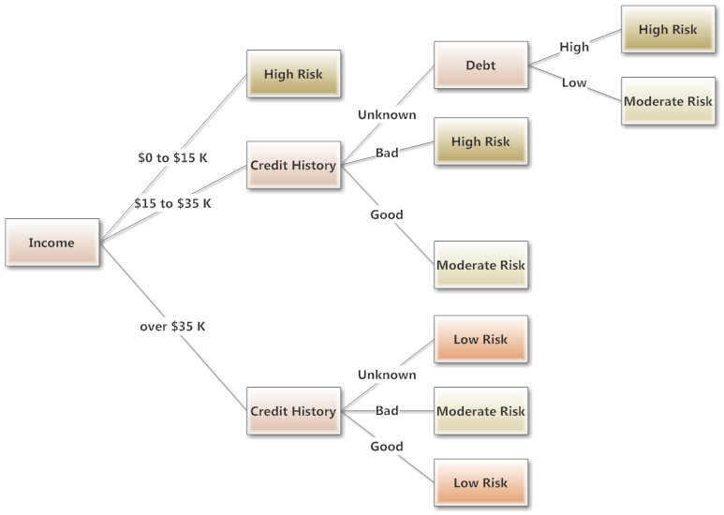
Example of Decision Tree in Home Loan

Slide 9
Naive Bayes Algorithm
A fruit may be considered to be an apple if it is red, round, and about 3″ in diameter. A Naive Bayes classifier considers each of these “features” (red, round, 3” in diameter) to contribute independently to the probability that the fruit is an apple, regardless of any correlations between features.
In a nutshell, the algorithm allows us to predict a class, given a set of features using probability. So in another fruit example, we could predict whether a fruit is an apple, orange or banana (class) based on its colour, shape etc (features).
It can be applied to Text Classification problems such as spam detection, sentiment analysis and categorization. By looking at documents as a set of words, which would represent features, and labels (e.g. “spam” and “ham” in case of spam detection) as classes we can start to classify documents and text automatically.
Notes:
http://blog.aylien.com/naive-bayes-for-dummies-a-simple-explanation/

Slide 10
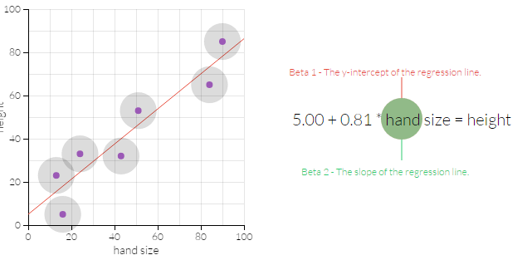
Ordinary Least Squares Regression
Statistical regression is basically a way to predict unknown quantities from a batch of existing data. For example, suppose we start out knowing the height and hand size of a bunch of individuals in a "sample population," and that we want to figure out a way to predict hand size from height for individuals not in the sample. By applying OLS, we'll get an equation that takes hand size---the 'independent' variable---as an input, and gives height---the 'dependent' variable---as an output.
Notes:
http://setosa.io/ev/ordinary-least-squares-regression/

Slide 11
Logistic Regression
Logistic regression is used in various fields, including machine learning, most medical fields, and social sciences. For example, the Trauma and Injury Severity Score (TRISS), which is widely used to predict mortality in injured patients, was originally developed by Boyd et al. using logistic regression.^{[4]}
Many other medical scales used to assess severity of a patient have been developed using logistic regression.^{[5][6][7][8]} Logistic regression may be used to predict whether a patient has a given disease (e.g. diabetes; coronary heart disease), based on observed characteristics of the patient (age, sex, body mass index, results of various blood tests, etc.).^{[1][9]} Another example might be to predict whether an American voter will vote Democratic or Republican, based on age, income, sex, race, state of residence, votes in previous elections, etc.^{[10]}
The technique can also be used in engineering, especially for predicting the probability of failure of a given process, system or product.^{[11][12]}
It is also used in marketing applications such as prediction of a customer's propensity to purchase a product or halt a subscription, etc.^{[13]}
In economics it can be used to predict the likelihood of a person's choosing to be in the labor force, and a business application would be to predict the likelihood of a homeowner defaulting on a mortgage. Conditional random fields, an extension of logistic regression to sequential data, are used in natural language processing.

Slide 12
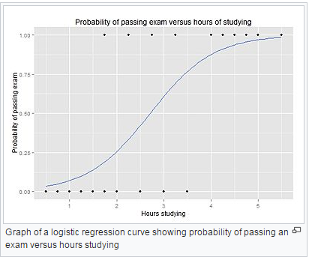
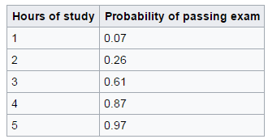
Example: Probability of passing an exam versus hours of study
Suppose we wish to answer the following question:
A group of 20 students spend between 0 and 6 hours studying for an exam. How does the number of hours spent studying affect the probability that the student will pass the exam?

Slide 13
Clustering Algorithms
Cluster customers based on their purchase histories
Cluster products based on the sets of customers who purchased them
Cluster documents based on similar words or shingles
Cluster DNA sequences based on edit distance
Clustering is a very important step in doing pattern analysis which leads to predictive analysis in machine learning.

Slide 14
What is SciPy, Numpy, matplotlib, pandas, sklearn?
SciPy
Open source Python library
Scientific computing and Technical computing
Optimization, linear algebra, integration, interpolation
Special functions, FFT, signal and image processing, ODE solvers
Numpy
Fundamental package for scientific computing with Python
Powerful N-dimensional array object
Sophisticated (broadcasting) functions.
matplotlib
Plotting library for the Python programming language
Numerical mathematics extension NumPy.
Object-oriented API for embedding plots into applications using general-purpose GUI toolkits like Tkinter, wxPython, Qt, or GTK+.

Slide 15
What is SciPy, Numpy, matplotlib, pandas, sklearn?
Pandas
Providing fast, flexible, and expressive data structures designed to make working with “relational” or “labeled” data both easy and intuitive.
High-level building block for doing practical, real world data analysis in Python.
Sklearn
Formerly scikits.learn
Free software machine learning library for the Python programming language.
Features various classification, regression and clustering algorithms including support vector machines, random forests, gradient boosting, k-means and DBSCAN, and is designed to interoperate with the Python numerical and scientific libraries Numpy and SciPy.

Slide 16
Demo Outline
Machine Learning Steps
1
Installation
2
Load The Data
3
Summarize the Dataset
4
Data Visualization
5
Evaluate some Algorithm
6
Make Predictions
7
Summary
8

Slide 17
Machine Learning Steps
Installing the Python and SciPy platform.
Loading the dataset.
Summarizing the dataset.
Visualizing the dataset.
Evaluating some algorithms.
Making some predictions.

Slide 18
Installation
Python version 2.7 or higher
5 key libraries
scipy
numpy
matplotlib
pandas
Sklearn
On Mac OS X, you can use macports to install Python 2.7 and these libraries
On Linux you can use your package manager, such as yum on Fedora to install RPMs.
Windows free version of Anaconda that includes everything you need.
https://www.continuum.io/downloads

Slide 19
Installation
Check Version of your python enter below command in your terminal
python -V
conda -V
# Check the versions of libraries
# Python version
import sys
print('Python: {}'.format(sys.version))
# scipy
import scipy
print('scipy: {}'.format(scipy.__version__))
# numpy
import numpy
print('numpy: {}'.format(numpy.__version__))
# matplotlib
import matplotlib
print('matplotlib: {}'.format(matplotlib.__version__))
# pandas
import pandas
print('pandas: {}'.format(pandas.__version__))
# scikit-learn
import sklearn
print('sklearn: {}'.format(sklearn.__version__))
Notes:
Python: 2.7.11 (default, Mar 1 2016, 18:40:10)
[GCC 4.2.1 Compatible Apple LLVM 7.0.2 (clang-700.1.81)]
scipy: 0.17.0
numpy: 1.10.4
matplotlib: 1.5.1
pandas: 0.17.1
sklearn: 0.18.1

Slide 20
Load The Data
Use the iris flowers dataset
It is “hello world” dataset in machine learning and statistics
Contains 150 observations of iris flowers
Four columns of measurements of the flowers in centimeters, fifth column is the species of the flower observed
Import Libraries:
# Load libraries
import pandas
from pandas.tools.plotting import scatter_matrix
import matplotlib.pyplot as plt
from sklearn import model_selection
from sklearn.metrics import classification_report
from sklearn.metrics import confusion_matrix
from sklearn.metrics import accuracy_score
from sklearn.linear_model import LogisticRegression
from sklearn.tree import DecisionTreeClassifier
from sklearn.neighbors import KNeighborsClassifier
from sklearn.discriminant_analysis import LinearDiscriminantAnalysis
from sklearn.naive_bayes import GaussianNB
from sklearn.svm import SVC

Slide 21
Load The Data
Load Dataset
Load the data directly from the UCI Machine Learning repository
Or you can load it from local Machine.
Download the iris.data file into your working directory and load it using the same method, changing URL to the local file name.
# Load dataset
url = "https://archive.ics.uci.edu/ml/machine-learning-databases/iris/iris.data"
names = ['sepal-length', 'sepal-width', 'petal-length', 'petal-width', 'class']
dataset = pandas.read_csv(url, names=names)

Slide 22
Summarize the Dataset
Dimensions of the dataset.
Peek at the data itself.
Statistical summary of all attributes.
Breakdown of the data by the class variable.

Slide 23
Data Visualization
Univariate plots to better understand each attribute.
Multivariate plots to better understand the relationships between attributes.

Slide 24
Evaluate Some Algorithms
Separate out a validation dataset.
Set-up the test harness to use 10-fold cross validation.
Build 5 different models to predict species from flower measurements
Select the best model.

Slide 25
Make Predictions
KNN algorithm was the most accurate mode
Accuracy of the model on our validation set
Independent final check on the accuracy of the best model
Run the KNN model directly on the validation set and summarize the results as a final accuracy score, a confusion matrix and a classification report.
# Make predictions on validation dataset
# Make predictions on validation dataset
knn = KNeighborsClassifier()
knn.fit(X_train, Y_train)
predictions = knn.predict(X_validation)
print(accuracy_score(Y_validation, predictions))
print(confusion_matrix(Y_validation, predictions))
print(classification_report(Y_validation, predictions))))

Slide 26
Use Case
Fraud Alert
Read a dataset of bank transactions
Data is present from Jan 2016 to Mar 2017.
Considering an average as follows:
Low Salaried – 2 credits, 10 debits
Medium Salaried – 5 credits, 20 debits
High Salaried – 10 credits, 50 debits
Predict which customers would have a higher probability of committing fraudulent transactions after Nov 8, 2016.
Assume higher credits but same number of debits.

Slide 27
Creating Dataset
Prepare Dataset:
With minimum 50,000 rows
Consider Bank transaction data set which has 1455 rows within it.
Append transaction details which is relevant to your use case, with existing bank transaction dataset.
Prepare dataset by using Java/Python

Slide 28
Voting Record Dataset
Figure who will be in Trump’s immigration Team.
He/She has to be a republican
If he has voted Y for immigration, check for education-spending
If he has voted N for immigration, check for crime
If he has voted Y for education-spending, reject candidate.
If he has voted N for education-spending, check for duty-free-exports.
If he has voted N for duty-fee-exports, reject candidate.
If he has voted Y for duty-free-exports, select candidate.
If he has voted Y for crime, select candidate.
Draw the decision table.
Print output of selected candidates
Print path for all selected candidates.

Slide 29
References
https://www.toptal.com/machine-learning/machine-learning-theory-an-introductory-primer
https://archive.ics.uci.edu/ml/machine-learning-databases/iris/iris.data
http://machinelearningmastery.com/machine-learning-in-python-step-by-step/
http://machinelearningmastery.com/setup-python-environment-machine-learning-deep-learning-anaconda/
https://pythonprogramming.net/machine-learning-tutorial-python-introduction/
https://pythonprogramming.net/linear-svc-example-scikit-learn-svm-python/
https://www.dataquest.io/blog/machine-learning-python/
http://blog.strands.com/strands-ai-machine-learning-era-banking

